Slide 1
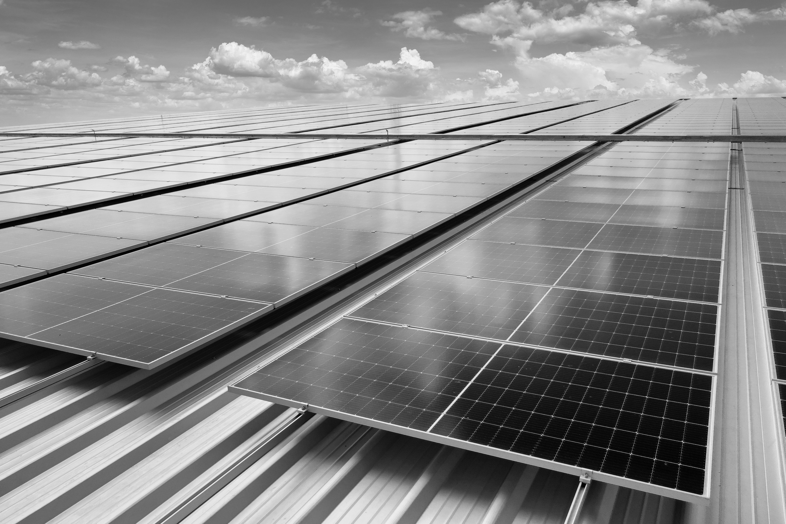
GRADUATION PROJECT
SOLAR PANEL
PRESENTATION

Slide 2
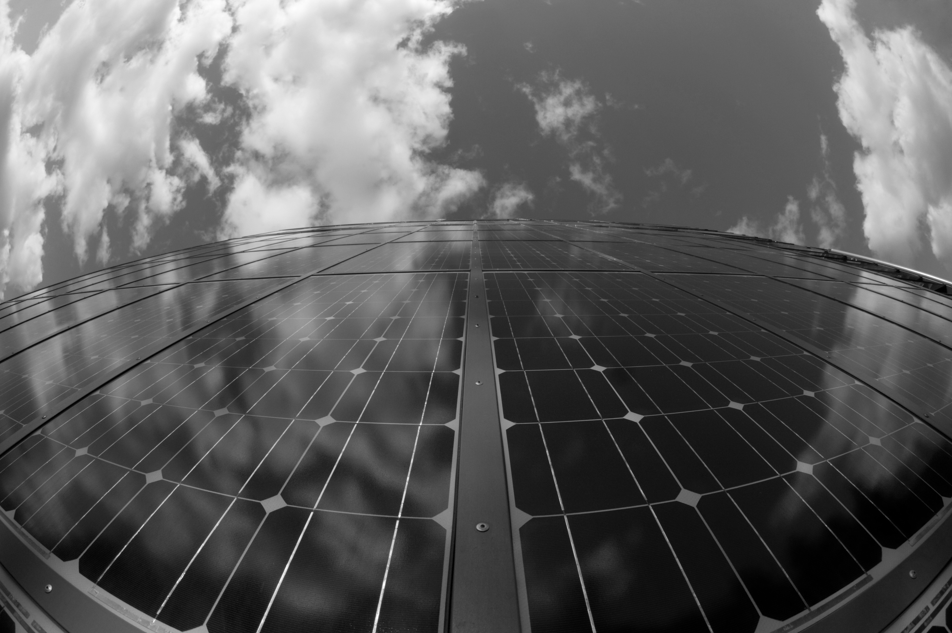
Introduction
Talk about the instructions we received:
A data engineer project that highlights sustentability

Slide 3

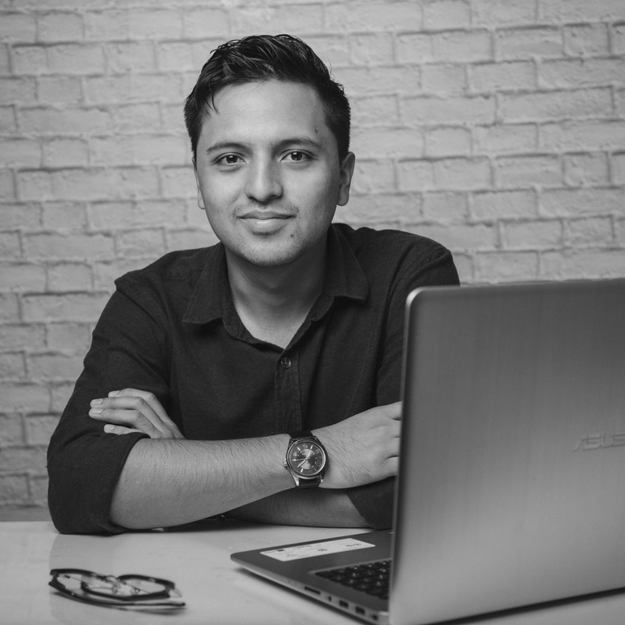
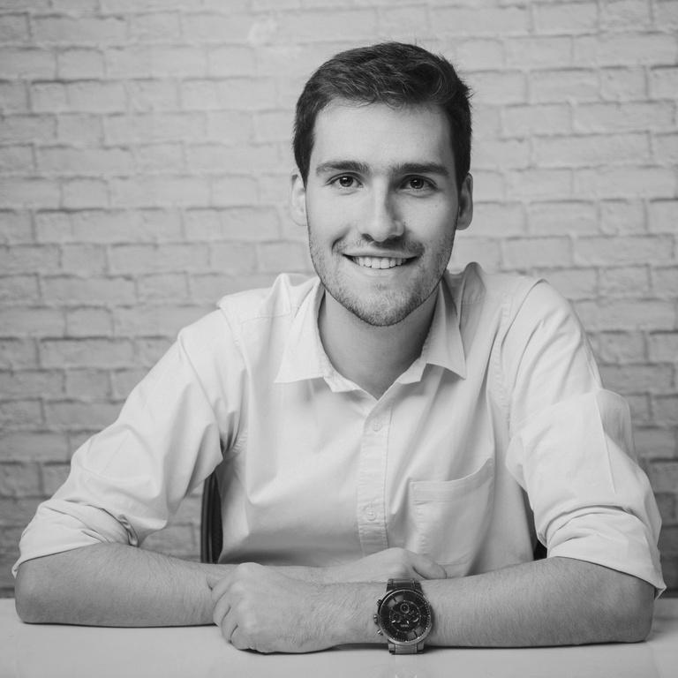
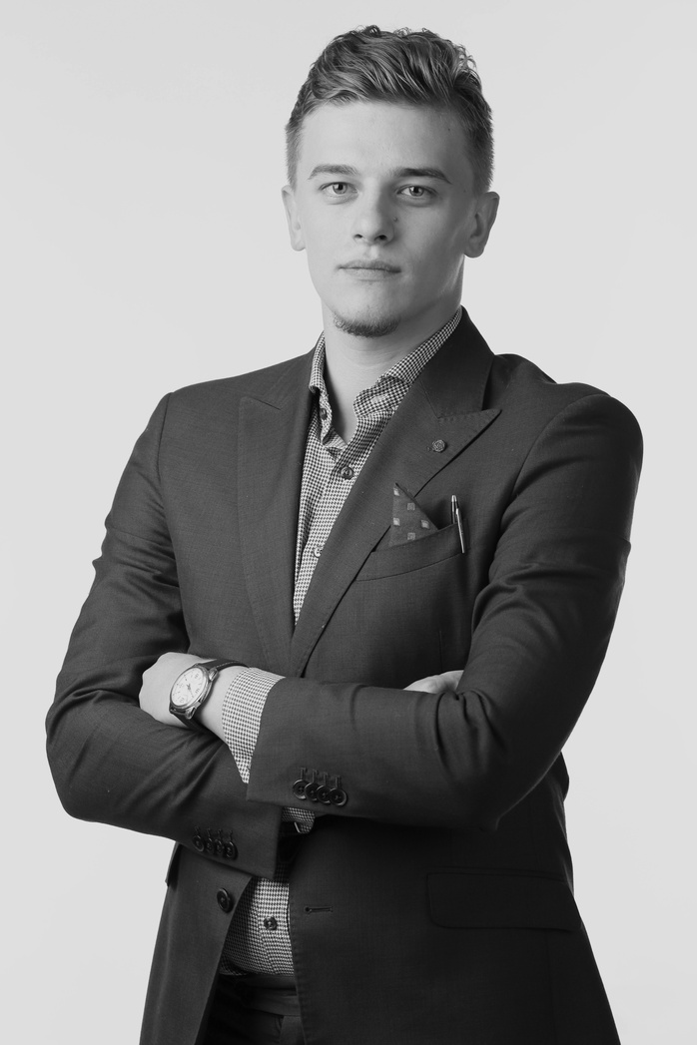
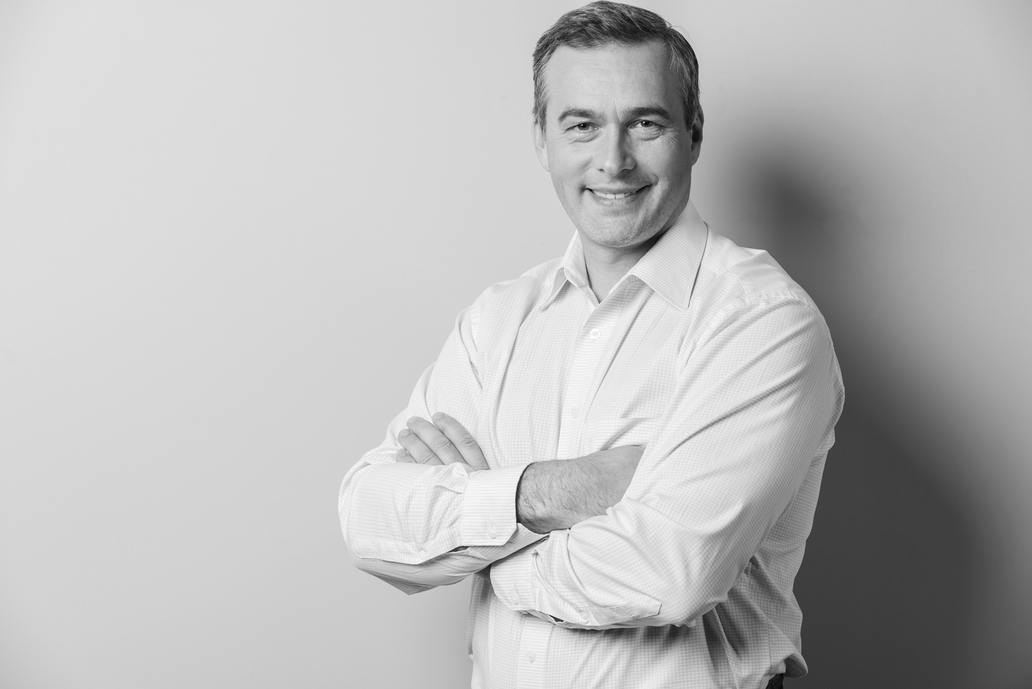
Meet The Best Team
CHIDI EZE
NEIL TRAN
REESE MILLER
MURAD NASER
Product Specialist
Management
Marketing Specialist
Chief Marketing

Slide 4
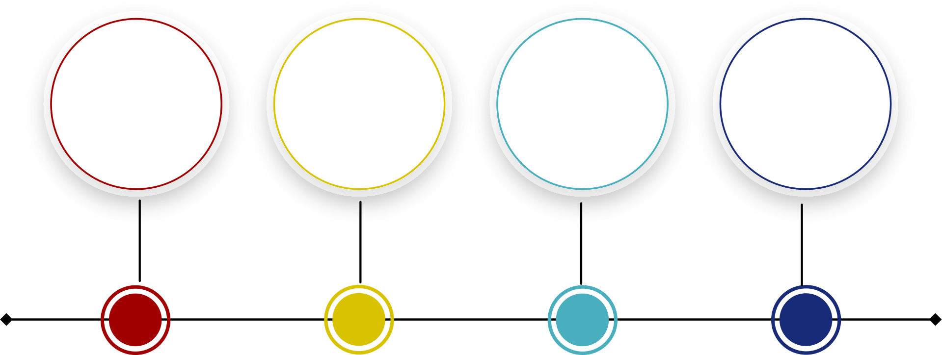
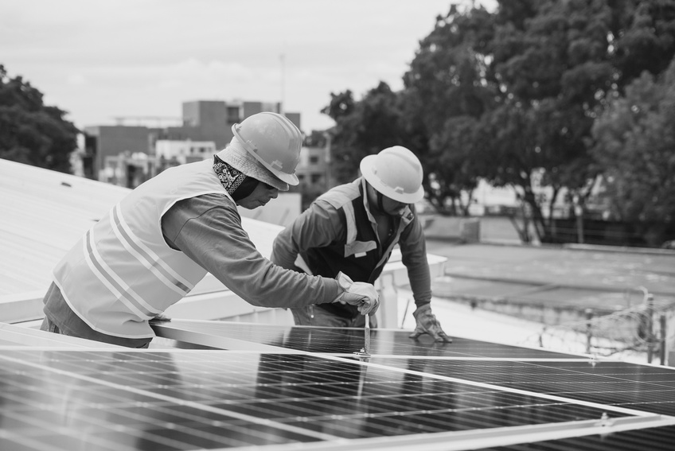
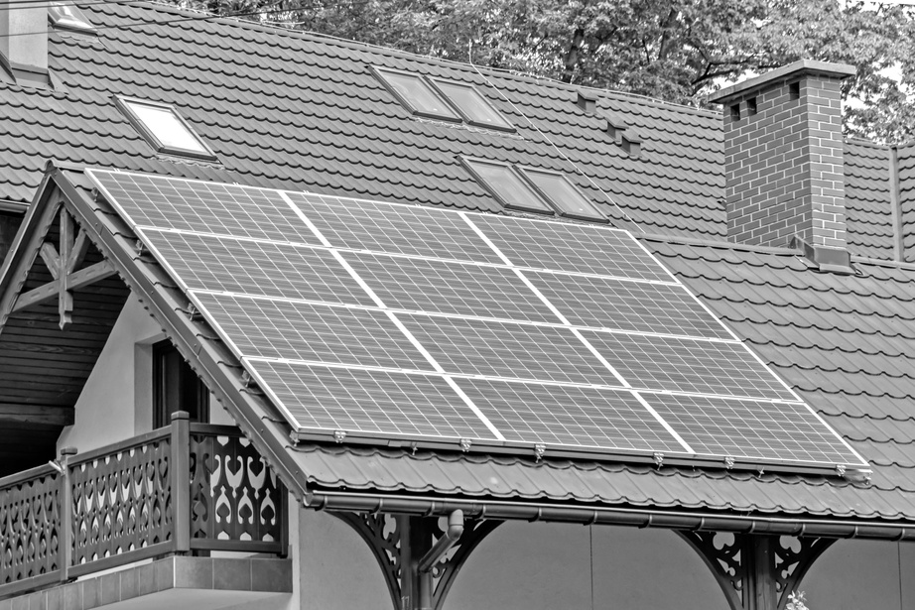
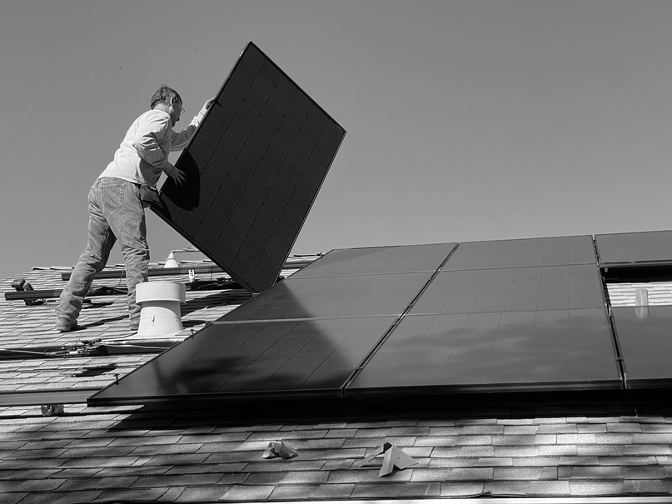
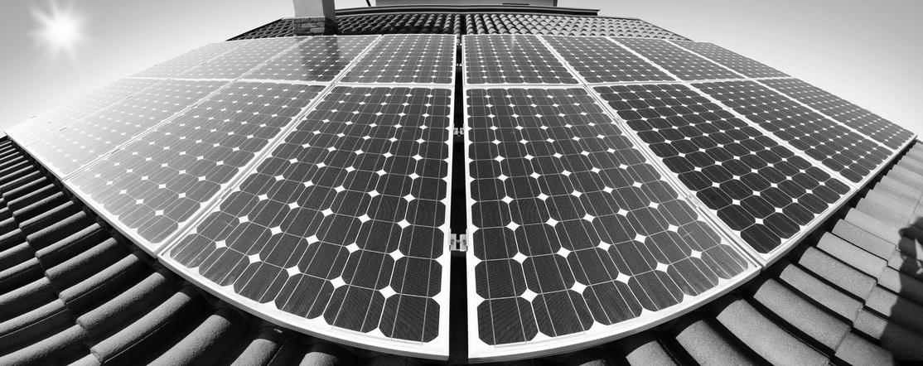
Agenda
THE PROBLEM
THE SCOPE
THE TECHNICAL STEPS
DEMO

Slide 5
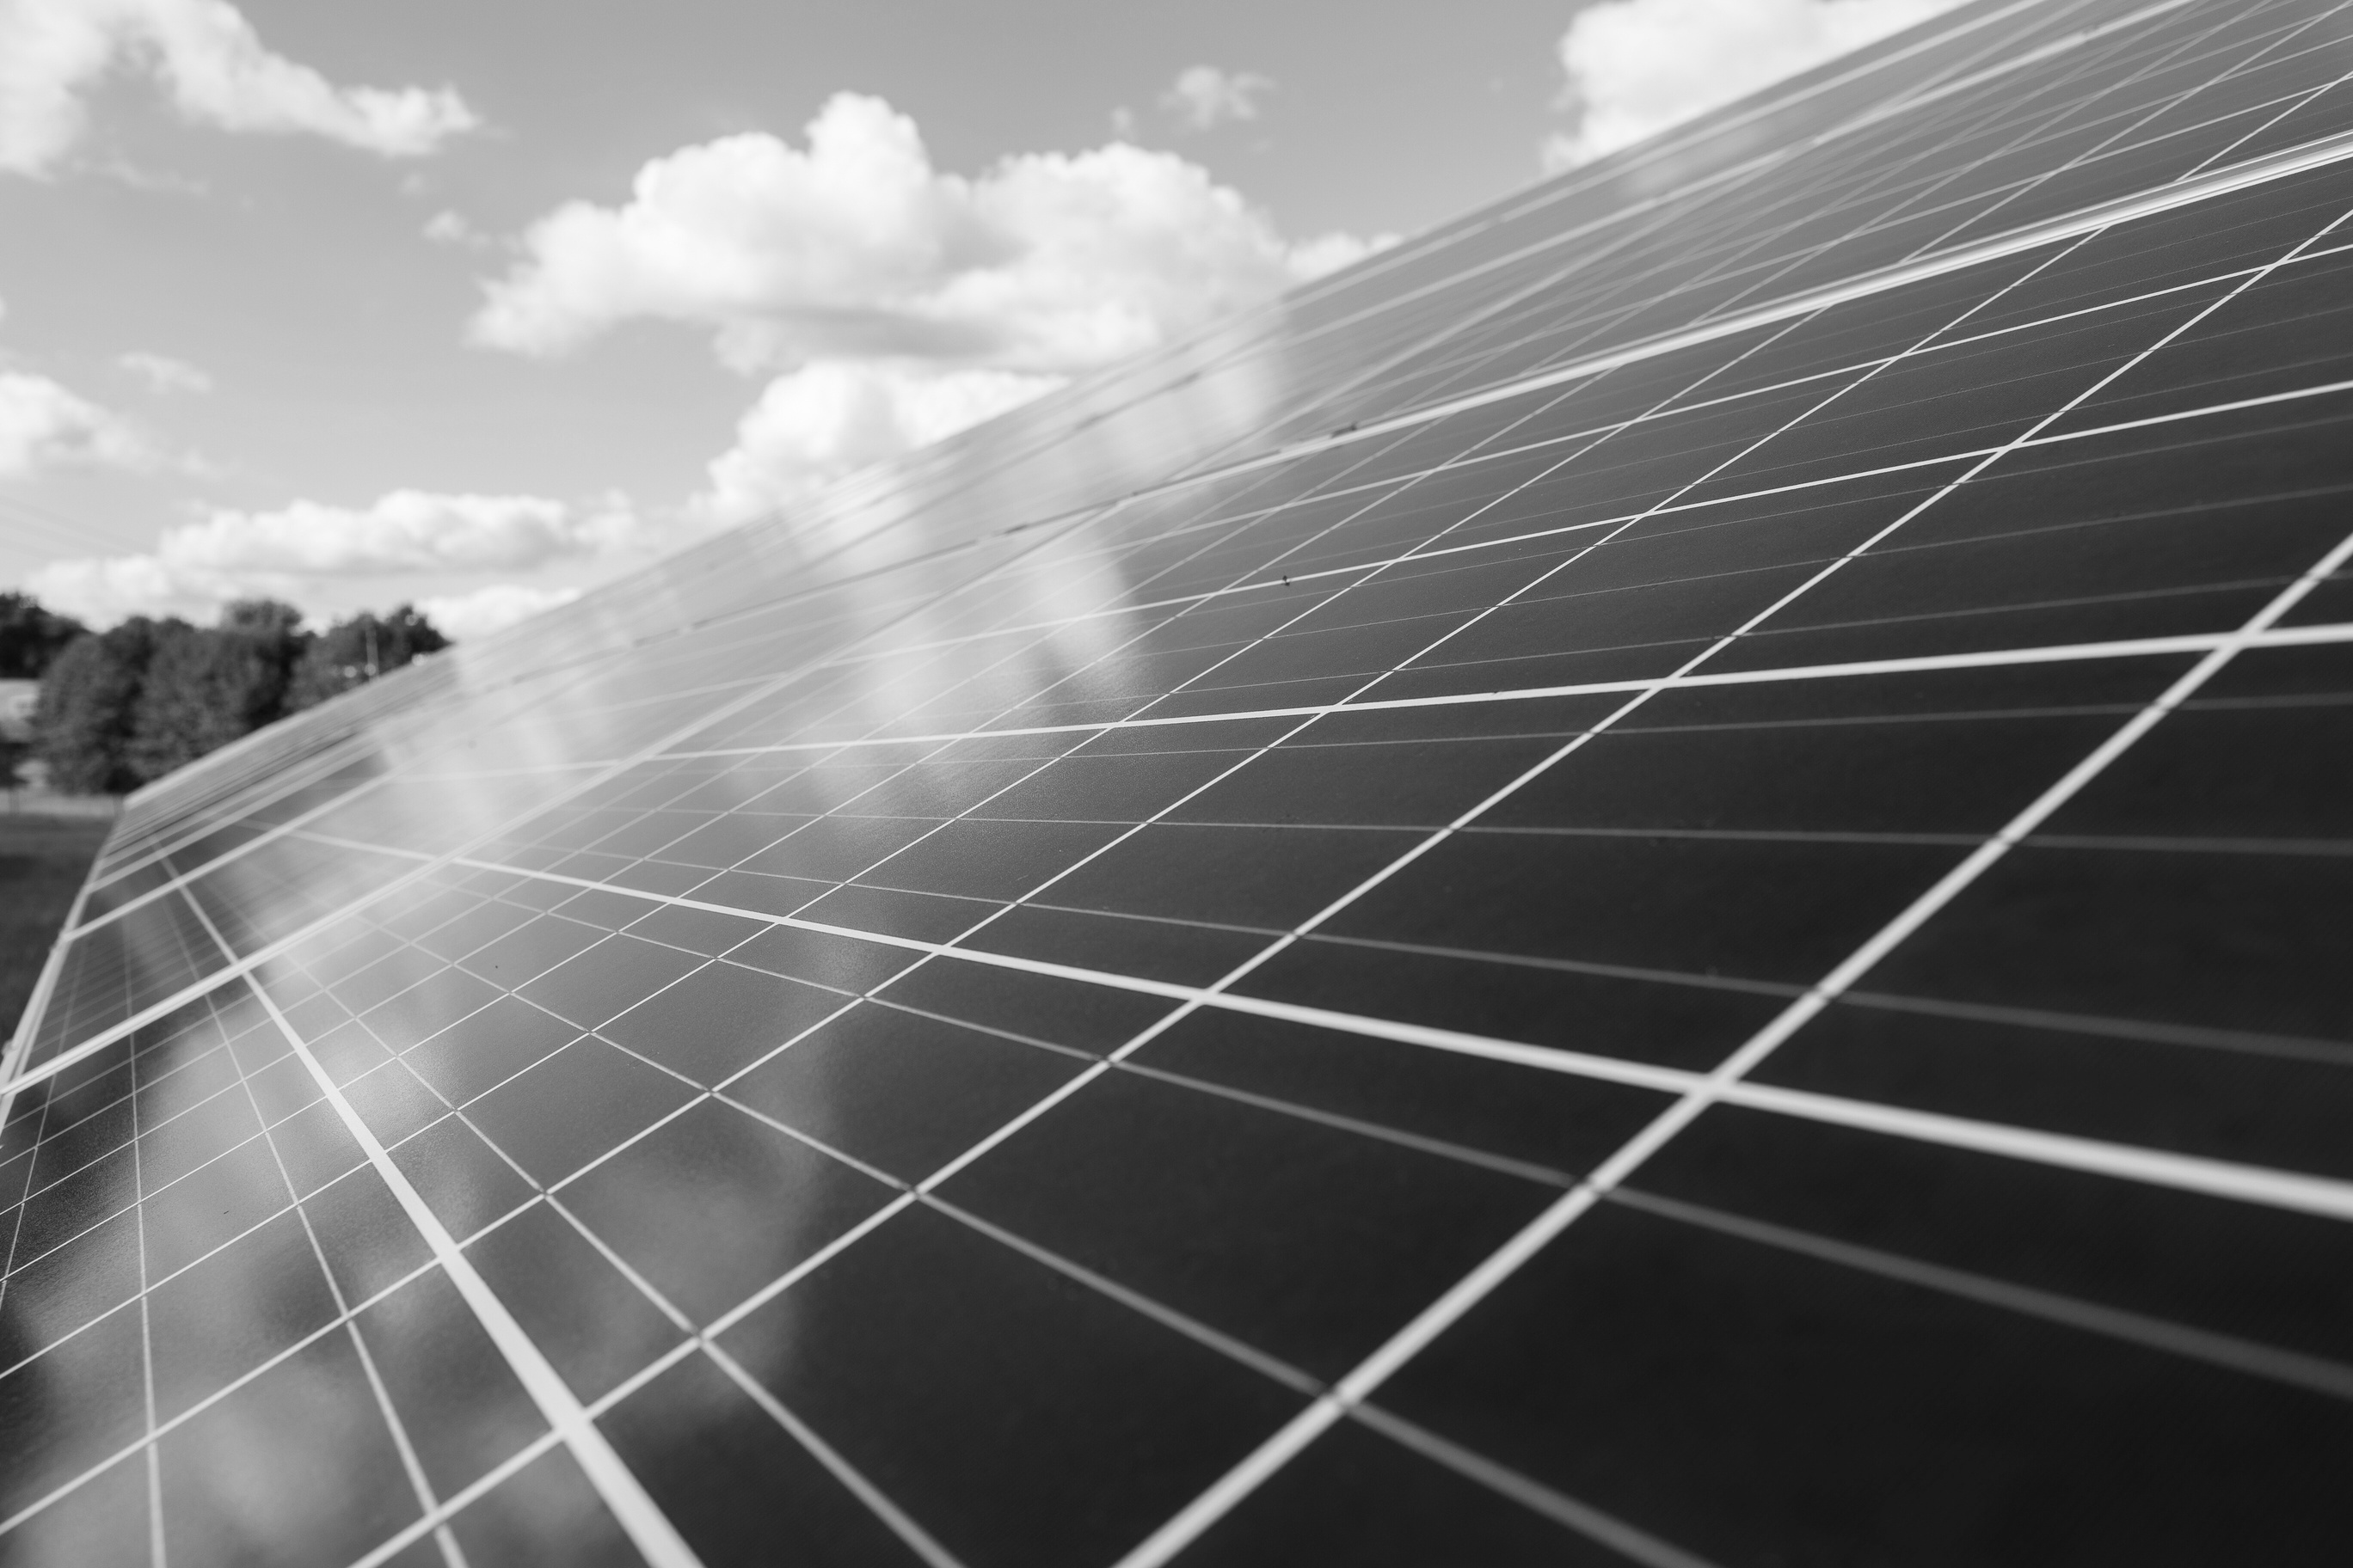
The Problem
History
Why is renewal energy important.
How much solar energyis used inSweden now (potential graph here to show it’s 2%?)
What isstopping people from using more solar energy? $$

Slide 6
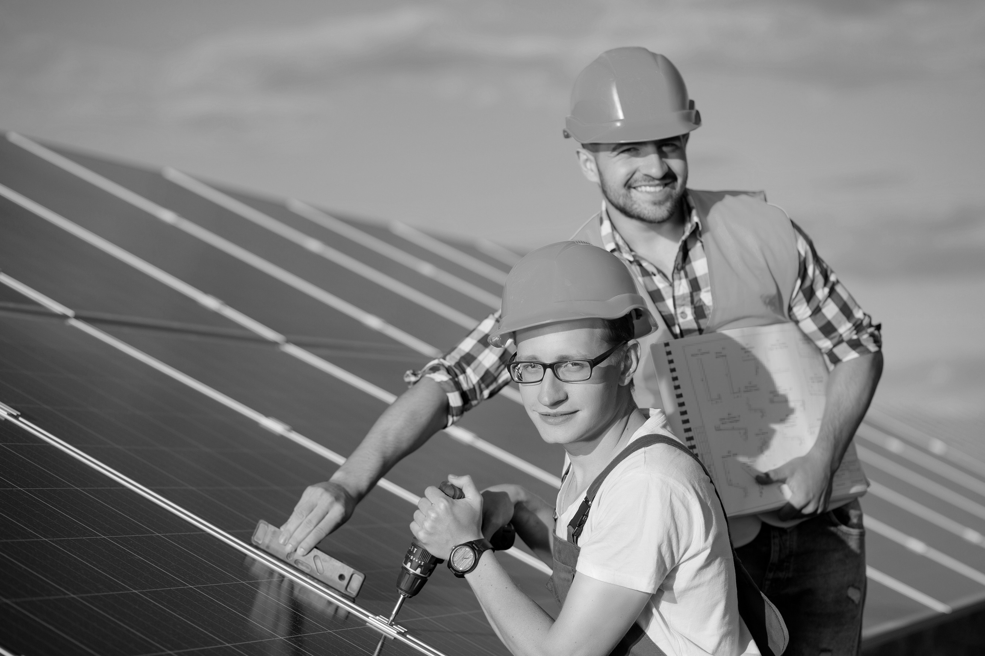




Our Solution
Scope
Philosophy 1
this
Philosophy 2
that
Philosophy 3
the bird
Philosophy 4
is the word

Slide 7




The Techniques
PYTHON
DATABASE
POUR LANGUAGE
?
ETL
VISUALISATION
cLEANING AND SORTING OUR DATA
DASH

Slide 8

DEMO
DASH
125
100
75
20-30
50
31-40
25
41-50
0
Item 1
Item 2
Item 3
Item 4
Item 5

Slide 9
Q & A

Slide 10
END OF PRESENTATION
THANK YOU.

